Slide 1
Recursion
Section 4
Chapter 6
© 2016 Pearson Education, Ltd. All rights reserved.

Slide 2


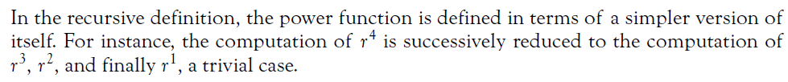
A Recursive Power Function
Recursive function invokes/calls itself
  Successive calls reduce to simpler task
  Until base case with trivial solution reached
The n^{th} power of a number
  Iteratively
  Recursively

Slide 3
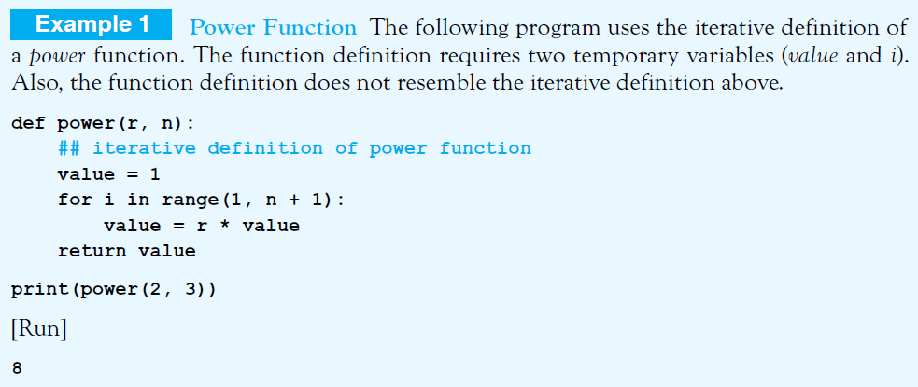
A Recursive Power Function
© 2016 Pearson Education, Ltd. All rights reserved.

Slide 4
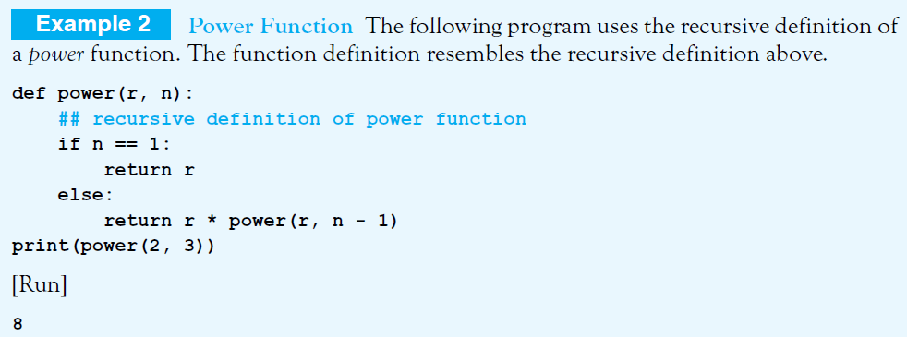
A Recursive Power Function

Slide 5
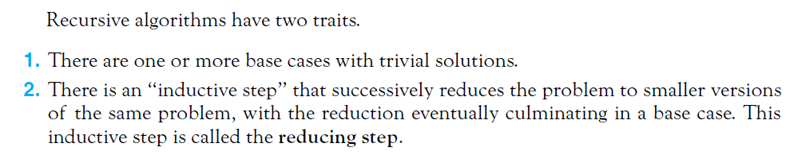
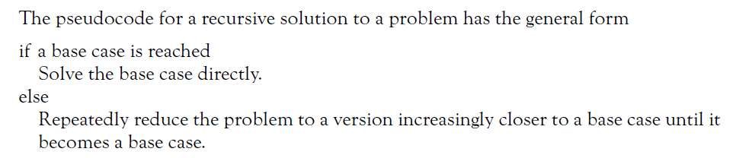
© 2016 Pearson Education, Ltd. All rights reserved.

Slide 6
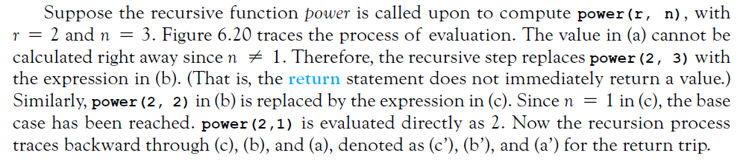
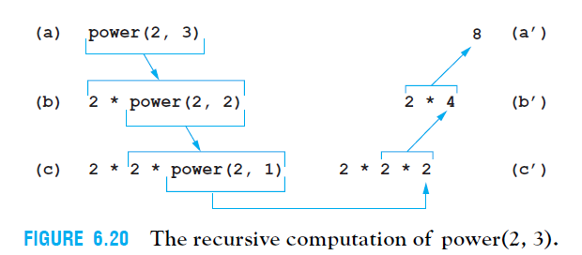
© 2016 Pearson Education, Ltd. All rights reserved.

Slide 7
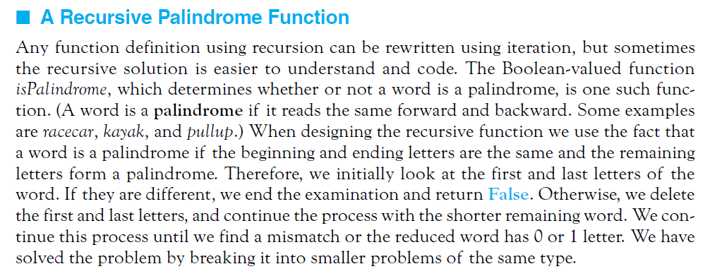
Recursive Palindrome Function
Sometimes a recursive solution is easier to understand and code than iterative routine.
© 2016 Pearson Education, Ltd. All rights reserved.

Slide 8
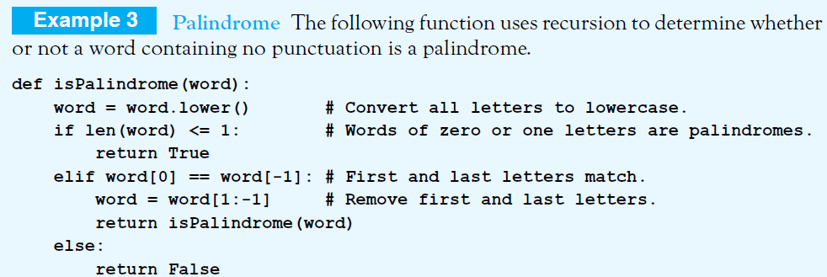
Recursive Palindrome Function
© 2016 Pearson Education, Ltd. All rights reserved.

Slide 9
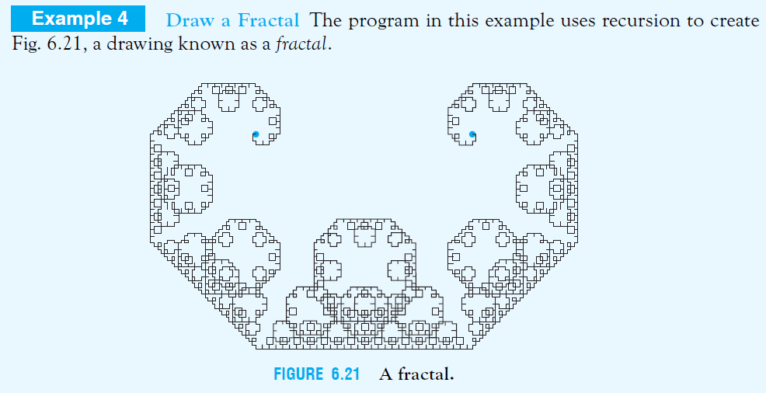
A Recursive Fractal Function
Note: Two blue dots to the figure are not part of the fractal. The drawing
begins at the left blue dot and ends at the right blue dot.

Slide 10


A Recursive Fractal Function
Four-step algorithm:
Specify an intricacy (complexity) level, a non-negative integer
Start with a straight line, level 0
To obtain the fractal for the next level, replace each line in the drawing with the sides of an isosceles right triangle having the line as hypotenuse. Level 1, 2, and 3 fractals:
Repeat step (c) until desired level reached

Slide 11
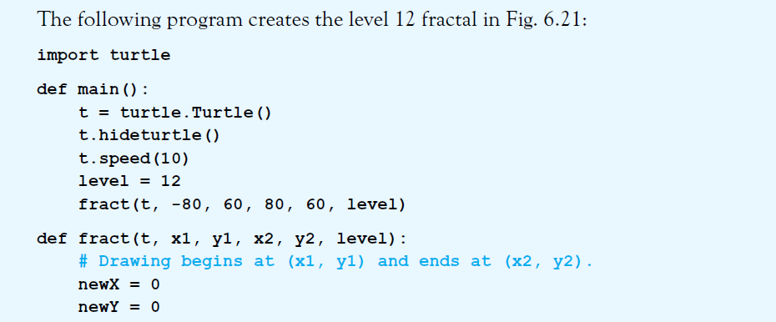
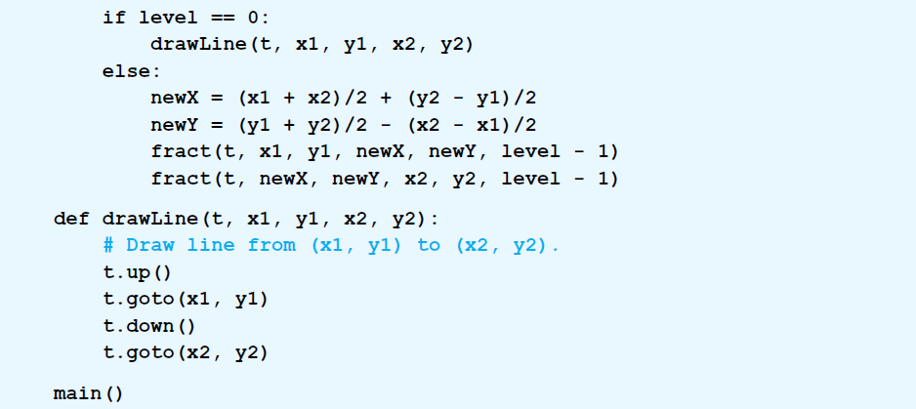
© 2016 Pearson Education, Ltd. All rights reserved.

Slide 12
End
Section 4
Chapter 6
© 2016 Pearson Education, Ltd. All rights reserved.

